Slide 1


Korea University
CUSTOMER CHURN PREDICTION
Using Machine Learning in Telecom Subscription Services
Presented by : Team 1
Arij Faiha
Huyngim Eng
Jessica Novita
Shi Xiao Yu
Notes:
prediction need to use Y at time t+h and X at time T (Prediction Horizon) and

Slide 2

PROJECT OVERVIEW
PROBLEM STATEMENT
OBJECTIVE
Customer churn represents a major challenge for telecommunication companies because losing customers directly affects long-term profitability and competitive advantage.
Acquisition costs 5-25x more than retention (Min et al., 2016)
5% retention increase can boost profits by 25-95% (Reichheld & Schefter, 2000)
Telecom churn rates average 20-50% annually
Improving the company’s retention strategy by build predictive churn models to:
Identify high-risk customers early
Understand key churn drivers (contract, tenure, charges)
Enable targeted retention campaigns
Reduce acquisition costs through improved retention
Min et al. (2016) - Acquisition vs. retention cost analysis Journal of Marketing Research
Reichheld & Schefter (2000) - Retention impact on profitability | Harvard Business Review
https://tridenstechnology.com/telecom-churn/

Slide 3
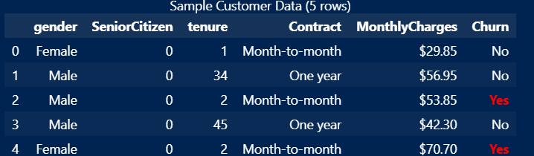

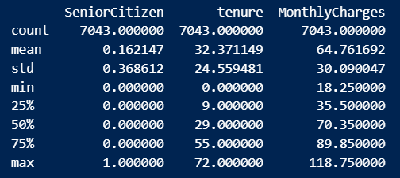





DATASET & METHODOLOGY
IBM Telco Customer Churn
Target:
7043
Churn (Yes/No)
Customers
21 Features
20 Variables
Objective:
Predict Customer Churn
1
2
3
4
5
Data Preprocessing
EDA
Feature Engineering
Model Training
Evaluation
Handle missing values
Encode categorical variables
Dropc olumn (TotalCharges)
Distribution Analysis
Correlation Heatmap Analysis
Visualization of Churn Patterns
45 Features Encoded
Stratified Split
StandardScaler pipeline
7 classifiers tested:
Logistic Regression, Random Forest, Decision Tree, AdaBoost, Gradient BM, XGBoost, LightGBM
Acuracy, Recall, Precision, F1 Score, AUC
Focus on Churn Recall
Cost-Benefit Analysis

Slide 4





DATA RATIONALE
Why this dataset?
Limitation
Widely used and credible
Synthetic Sample Dataset
The IBM Telco dataset is commonly used in churn prediction studies
May not fully reflect the complexity and noise of real telecom customer behavior.
Clear target variable
Possible class imbalance
Supports binary classification with Churn (Yes/No)
Has more non-churn than churn can make models may be biased
Managable size & structure
Limited real world variables
Large enough to achieve statistical significance and detect patterns
Important factors such as customer satisfaction, complaints, or network quality are missing
Business relevant features
It includes demographics, tenure, contract, and billing information
No Time Dimension
Cannot analyze churn over time and track behavior changes or predict when churn happens
Accesible, reproducable & benchmarkable
Easy for all team members to use, replicate, and compare with prior studies
Notes:
Will result for more practical telecom company recently

Slide 5
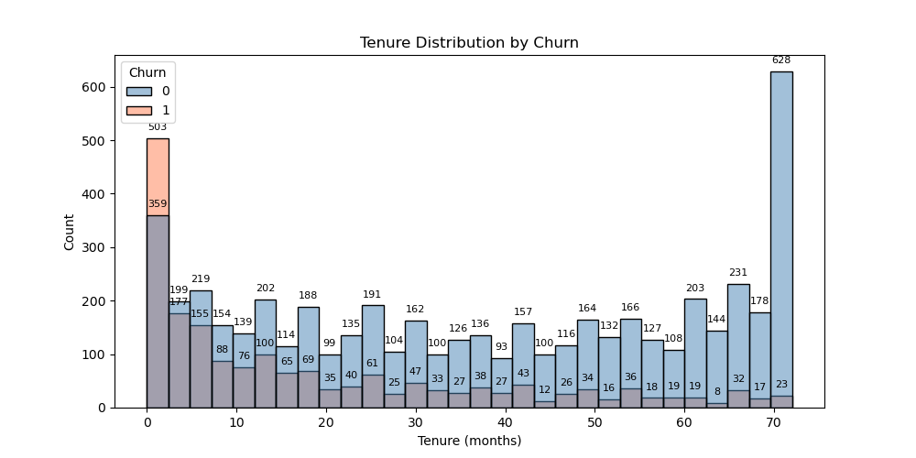
EDA: KEY FINDINGS - CHURN BY TENURE
New customers (month 0) churn the MOST: 359 out of 503
Churn drops sharply as tenure increases
70-month customers: 628 stayed, only 23 churned
Early retention programs are critical

Slide 6
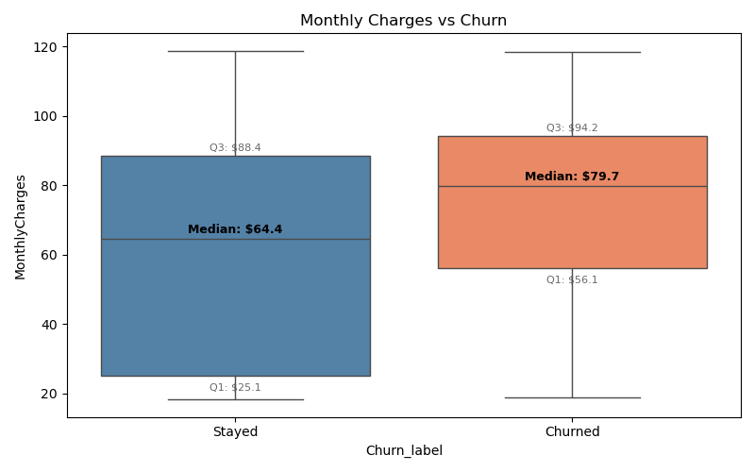
EDA: KEY FINDING - MONTHLY CHARGES VS CHURN
Churned customers pay a higher median: $79.7/month
Retained customers median: $64.4/month
High-paying customers feel less valued
Consider loyalty discounts for high-spend customers

Slide 7
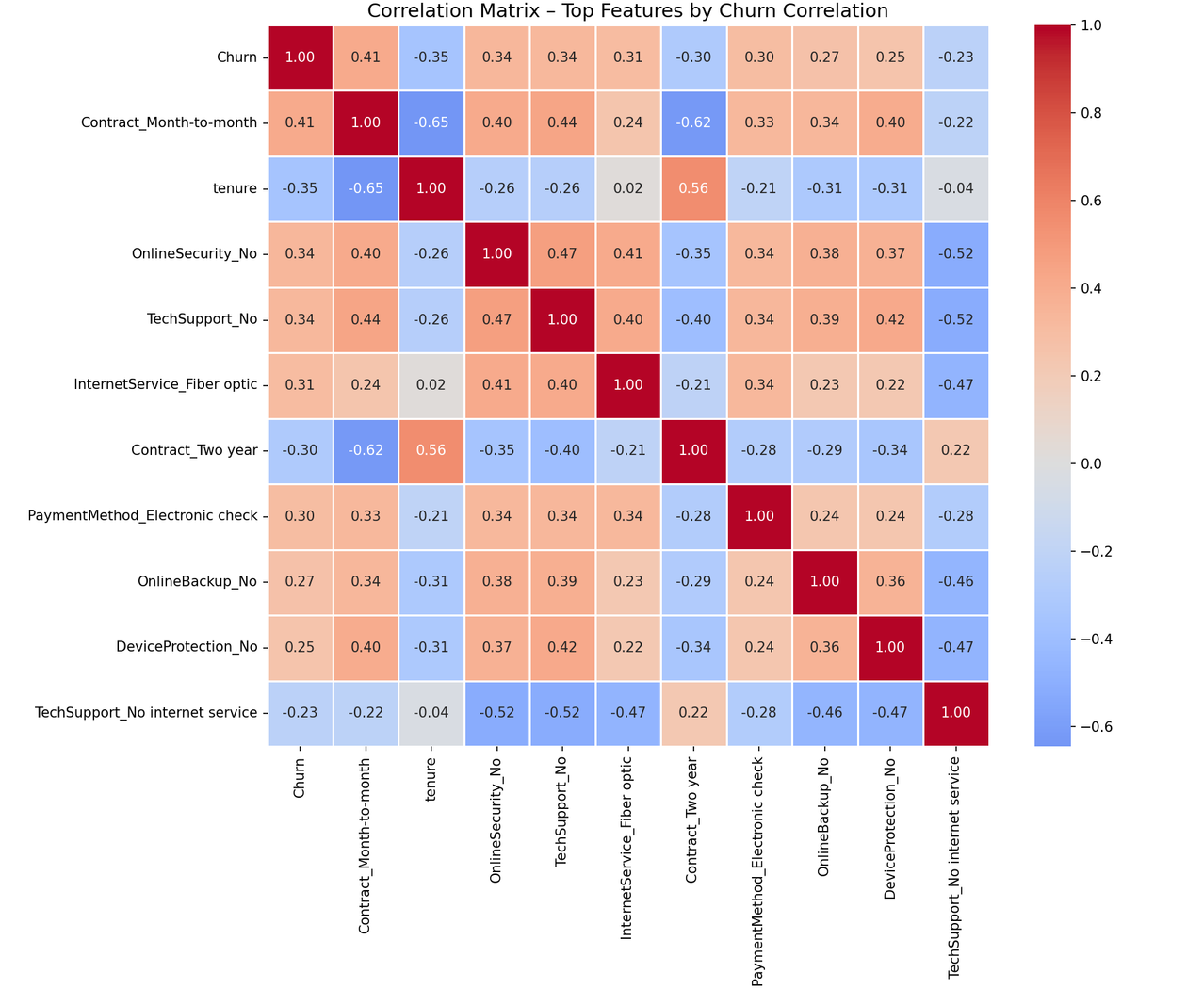
EDA: CORRELATION HEATMAP
Top Churn Driver:
Contract_Month_to_Month +0.41
Online_Security_No +0.34
Tech_Support_No +0.34
InternetService_Fiber_optic +0.31
Protective Factors:
tenure -0.35
Contract_Two_year -0.30

Slide 8

MODELLING APPROACH
Logistic Regression
Decision Tree
Random Forest
Data Split Strategy
Handling Class Imbalance
80% Train | 10% Val | 10% Test
73.5% stayed vs 26.5% churned
Applied stratify to preserve churn ratio across all sets
Added Pipeline (StandardScaler to the model) to prevent data leakage during scaling
Applied class_weight='balanced' to Logistic Regression
Hyperparameter Tuning (Random Forest)
Method: GridSearchCV
Result hyperparameter to be tuned:
{'max_depth': 10, 'min_samples_split': 5, 'n_estimators': 50}
Prioritize Recall over Accuracy due to class imbalance (26.5% churn)

Slide 9
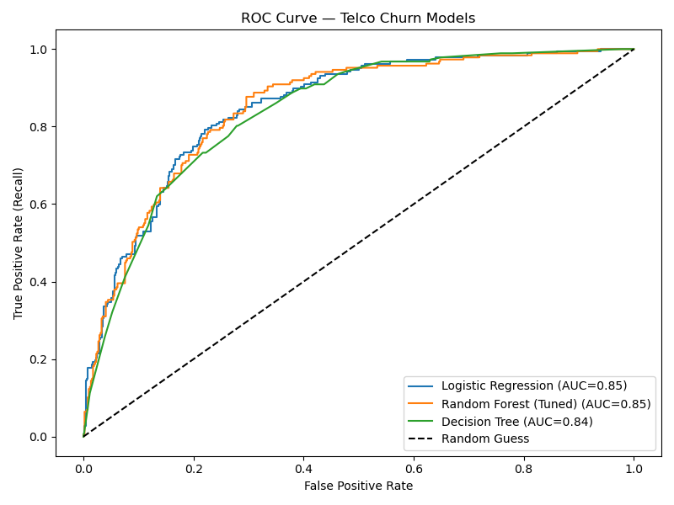
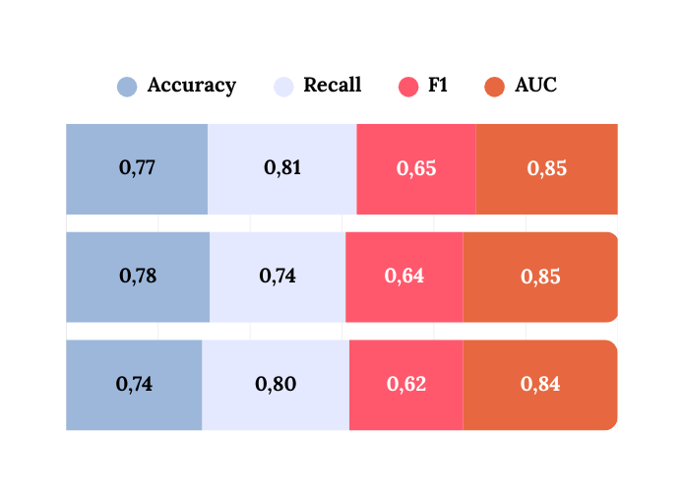

MODEL COMPARISON - VALIDATION SET
Logistic Regression
Random Forest
Decision Tree
→ Selected LR for Final Test evaluation
Our results align with published benchmarks on the IBM Telco Churn dataset, where well-validated models typically achieve 77–85% accuracy and AUC 0.82–0.87 (Mandak, 2019; arXiv, 2022).
Accuracy above 90% on this dataset is a red flag, likely indicating data leakage or overfitting, not a better model.
AUC = probability that the model ranks a churner above a non-churner. Closer to 1.0 = better.
Recall = % of actual churners correctly caught. We prioritise this over accuracy due to class imbalance (26.5% churn).
Mandak, J. (2019). Analyses of customer churn prediction in telecommunications (No. 32019719Q2_129). Czech Statistical Office. https://csu.gov.cz/docs/107508/7e7d54fb-dc58-527a-c0f5-78b12254b8dd/32019719q2_129_mandak_analyses.pdf

Slide 10
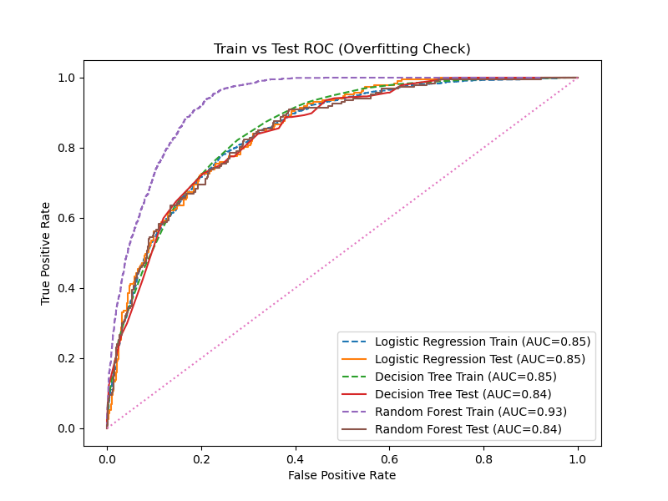

OVERFITTING ANALYSIS - TEST & TRAIN SET
Logistic Regression
Train: 0.845 | Test: 0.849 | Gap: -0.004
Model generalises perfectly, zero overfitting
Decision Tree
Train: 0.852 | Test: 0.843 | Gap: +0.009
Random Forest
Train: 0.929 | Test: 0.844 | Gap: +0.085 ⚠
Model memorised training data (overfitting)
Higher complexity ≠ better generalisation
Logistic Regression (simplest model) matches Random Forest on Test AUC (0.849 vs 0.844) with zero overfitting risk

Slide 11
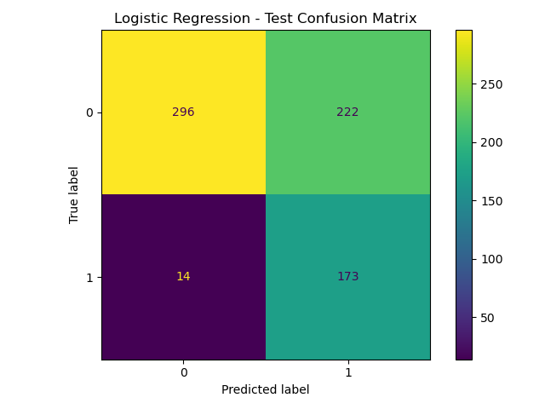
CONFUSION MATRIX
LOGISTIC REGRESSION
TN (True Negative) = 396
→ Correctly predicted non-churn customers
FP (False Positive) = 222
→ Non-churn customers flagged as churn
FN (False Negative) = 14
→ Churn customers missed by the model
TP (True Positive) = 173
→ Correctly identified churn customers
Effective for churn detection, with moderate false alarms

Slide 12
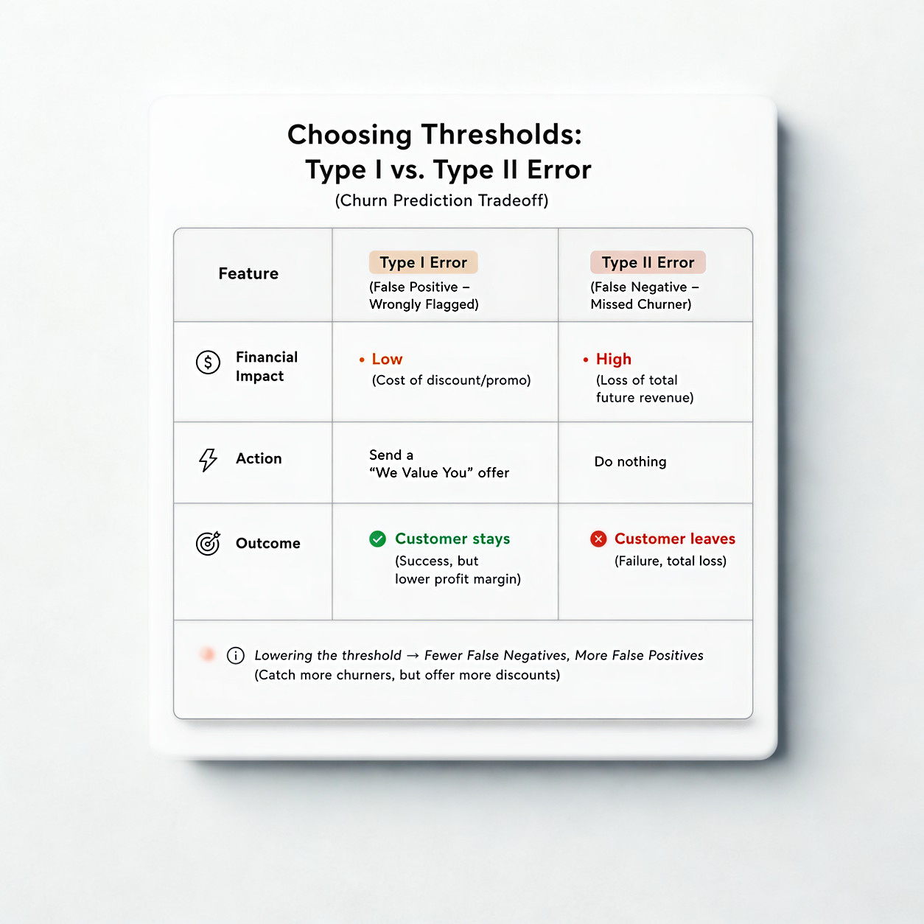
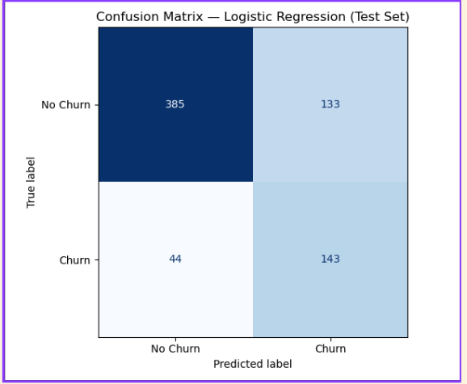
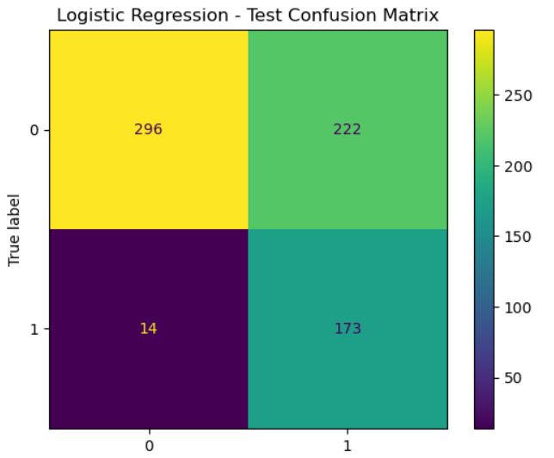
COST-BENEFIT ANALYSIS
To make our model more sensitive, we move away from the default 50% threshold and manually set a new one, such as 30%.
By making this shift, we are effectively deciding that it is far better to "over-protect" than to suffer the irreparable cost of losing even one because we weren't paying attention.
Before
After

Slide 13
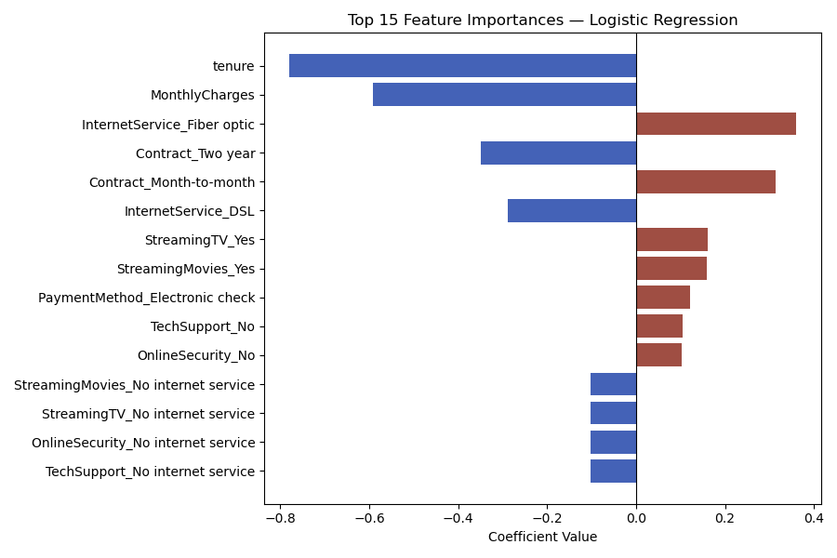
FEATURE IMPORTANCE
LOGISTIC REGRESSION
Tenure is #1 protective factor. Means the longer customer stays, the less likely they churn.
largest blue bar with coefficient ~0.8
Fiber optic internet users churn the most. Possibly due to price sensitivity or competition.
(Largest red bar, coefficient ~+0.4)
Contract Type appears on BOTH sides.
Month-to-month = churn risk
2-year = retention anchor
Notes:
Check the beta

Slide 14
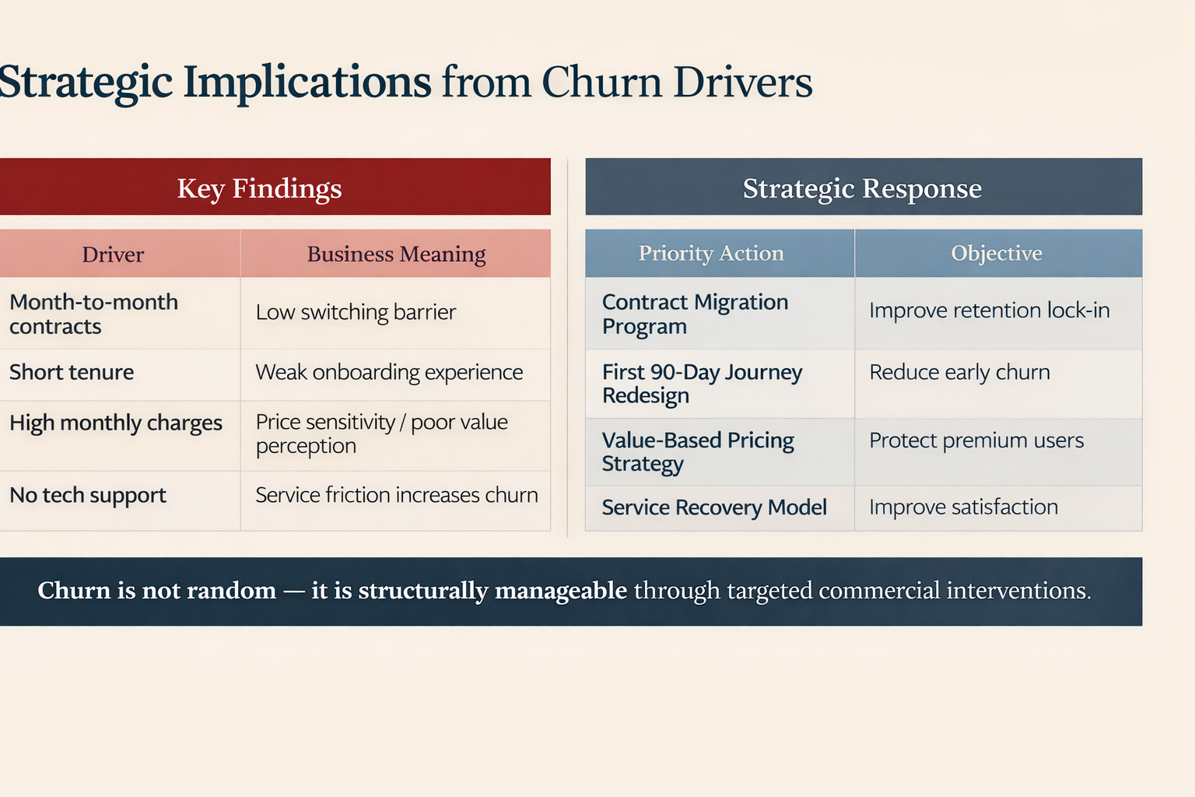

STRATEGIC IMPLICATION
From Churn Drivers

Slide 15
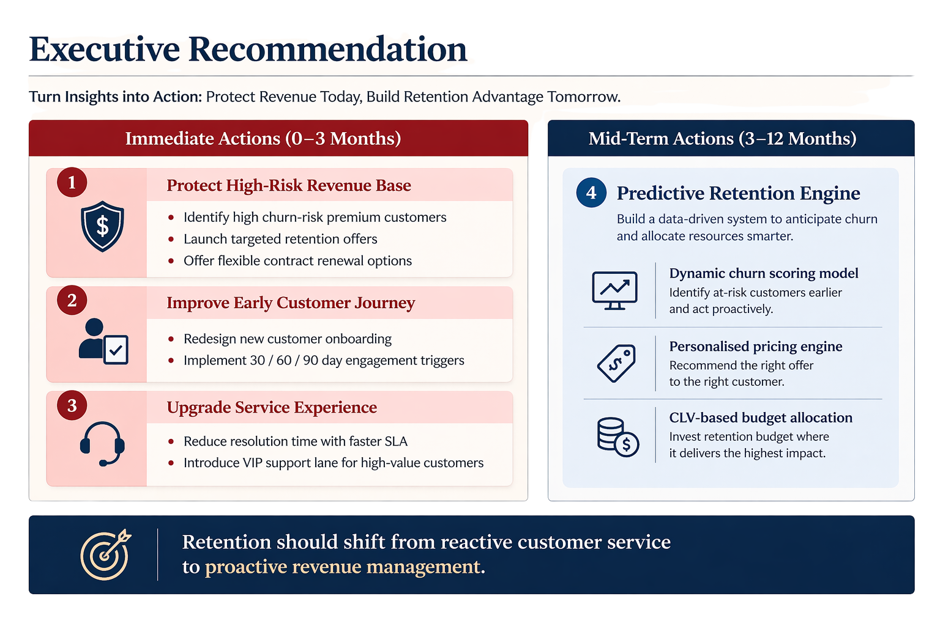
EXECUTIVE RECOMMENDATION
Turn Insights into Action: Protect Revenue Today, Build Retention Advantege Tommorow

Slide 16

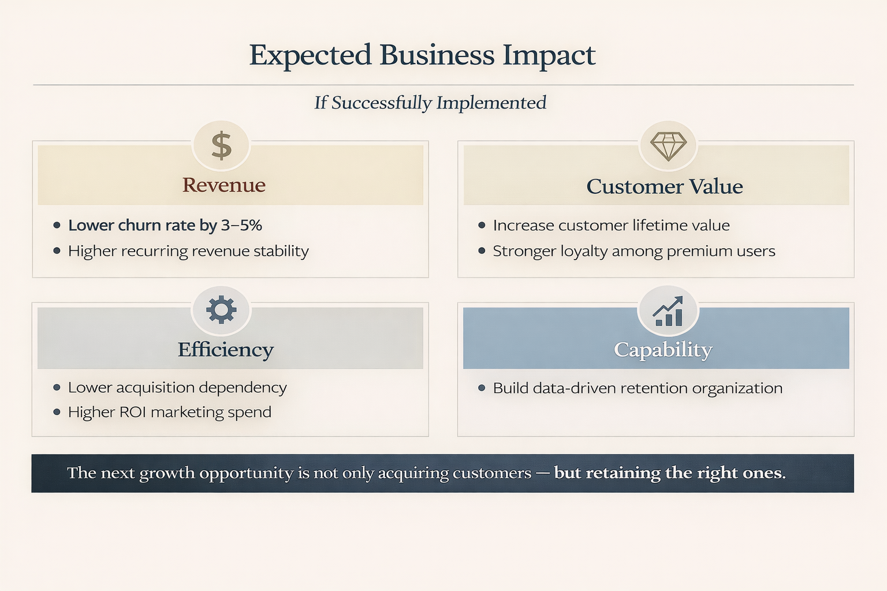
EXPECTED BUSINESS IMPACT
If Successfully Implemented

Slide 17

THANK YOU!
References
Byun, K., Hong, J., Kim, B., & Park, J. (2024). Innovation in financial inclusion policies with digital transformation: Evidence from South Korea. Asia-Pacific Journal of Financial Studies, 53(1), 128–154. https://doi.org/10.1111/ajfs.12467
Hunter, J. D. (2007). Matplotlib: A 2D graphics environment (Version 3.8). https://matplotlib.org
IBM. (2017). Telco Customer Churn [Dataset]. Kaggle. https://www.kaggle.com/datasets/blastchar/telco-customer-churn/data
Kim, B. (2026). ML Business Applications with Python [Lecture slides]. Korea University Business School, GMBA Program.
Mandak, J. (2019). Analyses of customer churn prediction in telecommunications (No. 32019719Q2_129). Czech Statistical Office. https://csu.gov.cz/docs/107508/7e7d54fb-dc58-527a-c0f5-78b12254b8dd/32019719q2_129_mandak_analyses.pdf
McKinney, W. (2010). pandas: Python Data Analysis Library (Version 2.0). https://pandas.pydata.org
Min et al. (2016) - Acquisition vs. retention cost analysis Journal of Marketing Research
Pedregosa, F., et al. (2011). Scikit-learn: Machine learning in Python (Version 1.3). https://scikit-learn.org
Reichheld & Schefter (2000) - Retention impact on profitability | Harvard Business Review https://tridenstechnology.com/telecom-churn/
Richard, R. (n.d.). Telco Customer Churn Analysis Dashboard [Dataset]. Kaggle. https://www.kaggle.com/datasets/reignrichard/telco-customer-churn-analysis-dashboard
Sakib, A. S. (n.d.). Churn Prediction I: EDA & Statistical Analysis [Notebook]. Kaggle. https://www.kaggle.com/code/ahmedshahriarsakib/churn-prediction-i-eda-statistical-analysis#9-Conclusion
Stein, R. M. (2005). The relationship between default prediction and lending profits: Integrating ROC analysis and loan pricing. Journal of Banking & Finance, 29(5), 1213–1236. https://doi.org/10.1016/j.jbankfin.2004.04.008
Seymen, O. F., Hacioglu, U., & Nantembelele, F. A. (2022). Customer churn prediction modeling: A comparative study of machine learning methods (arXiv:2201.04088). arXiv. https://arxiv.org/abs/2201.04088

Slide 18
AI USAGE STATEMENT
This project utilized AI as a supporting tool during the exploratory data analysis phase.
All data analysis, interpretation of results, business insights, and final decisions were performed independently by the team. All AI-generated suggestions were reviewed, verified, and adapted before use.
AI Tool:
Perplexity AI (Sonnet 4.6)
M365 Copilot AI (Smart Function)
GPT-5.4 Thinking

Slide 19
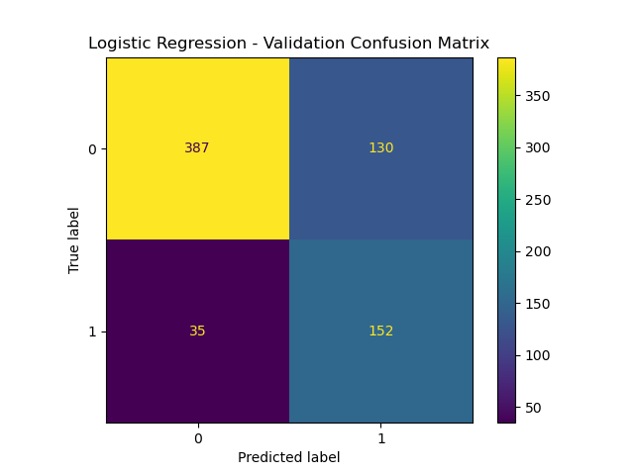
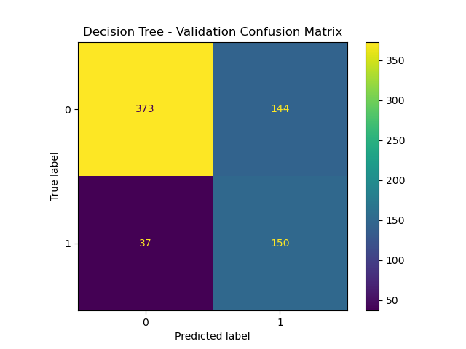
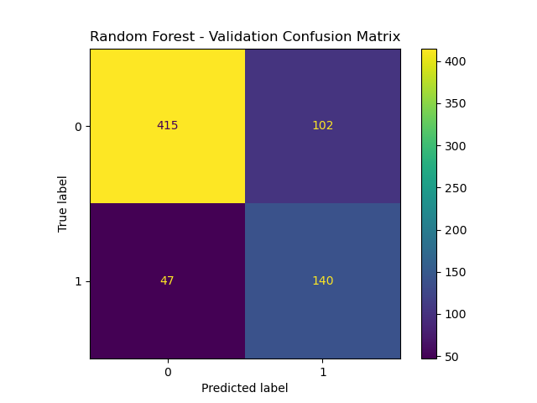
APPENDIX
Comparison Confusion Matrix - Validation Set

Slide 20
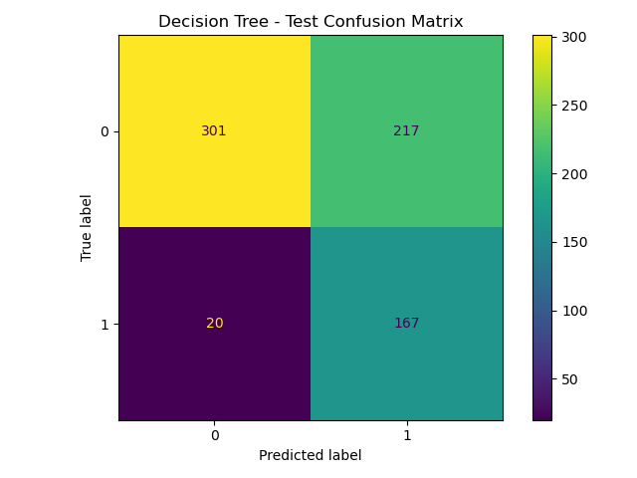
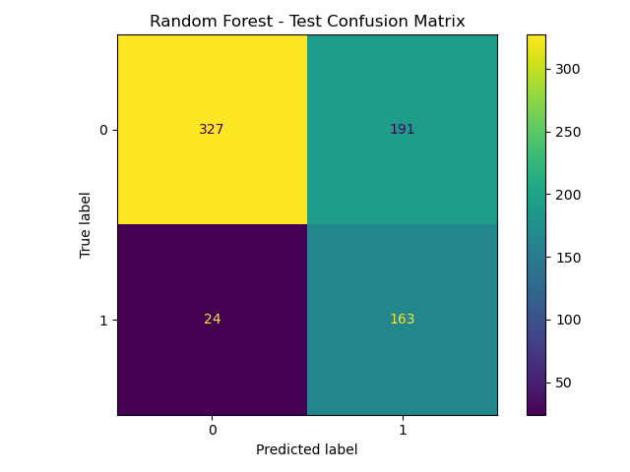
APPENDIX
Comparison Confusion Matrix - Test Set

Slide 21
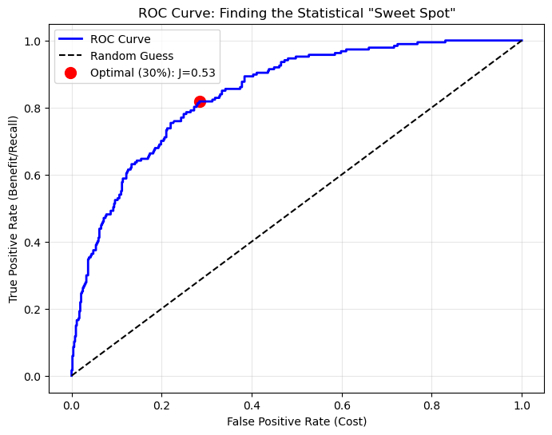
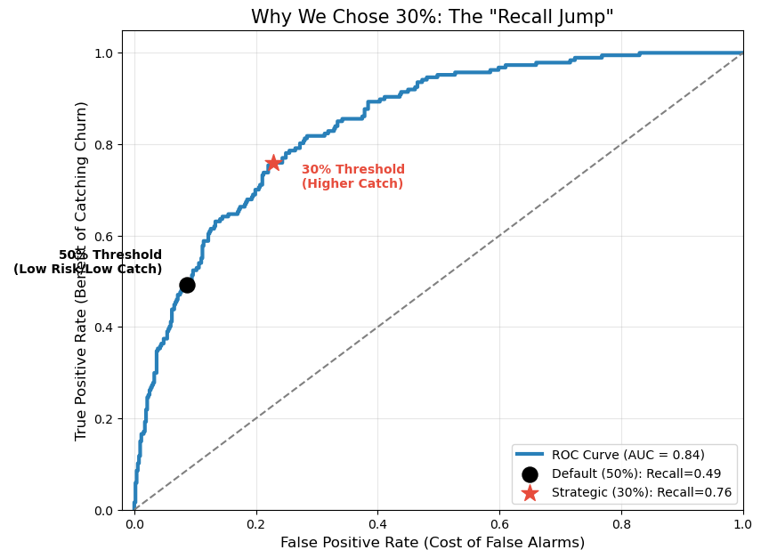
APPENDIX
Why choosing 30% threshold?

Slide 22
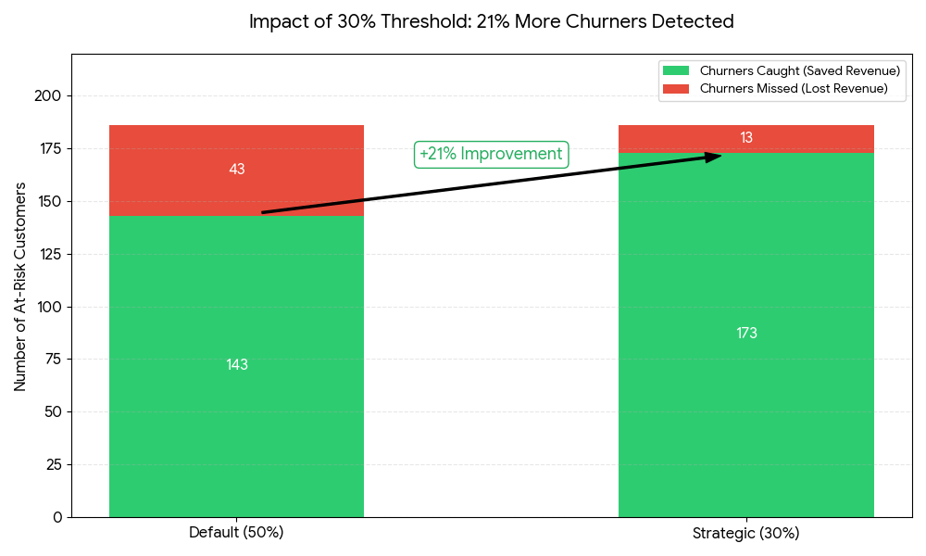
APPENDIX
Why choosing 30% threshold?
The 21% Revenue Catch: We increased our ability to identify true churners by 20.98%. This is exactly the type of 'Analytical Innovation' that Byun et al. (2024) describes as the key to reaching modern customers. We moved from catching 143 families to 173.

Slide 23
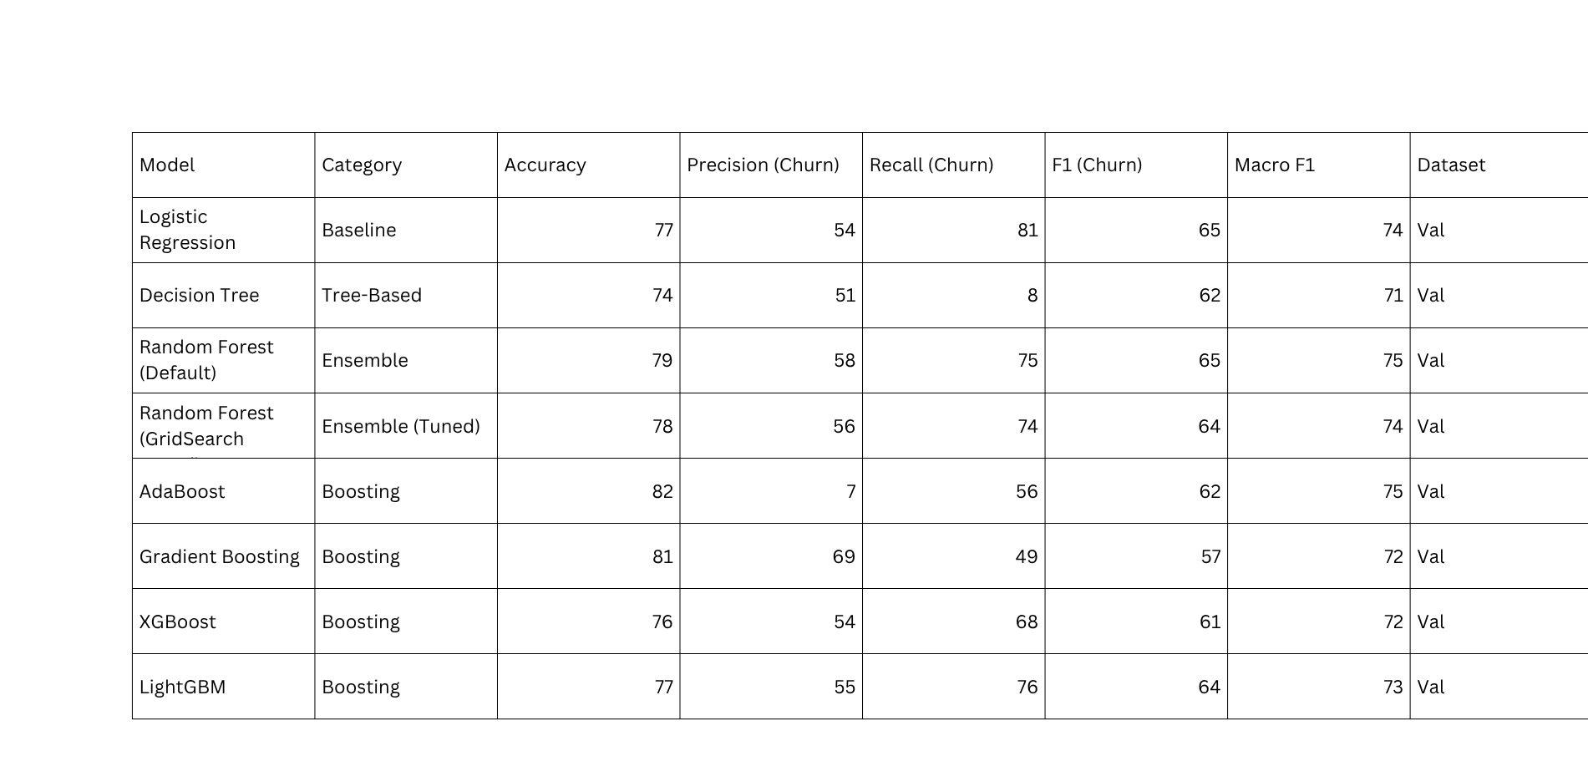
APPENDIX
Comparison of all classification models tested

